Slide 1



SUKUNA MULTIPLE CAMPUS
Tribhuvan University
Impact of Artificial Intelligence (AI) Tools on Students' Learning and Academic Integrity
PRESENTED BY
SUPERVISOR
Abishek Khawas
Mr. Biplab Dhakal
Roll No: 78214004
Faculty Member
Regd No: 9-2-214-36-2021

Slide 2










Introduction
AI tools are transforming student learning, raising concerns about academic integrity and ethical use in education.
AI in Education
Academic Integrity
The Ethical Shift
Generative AI tools like ChatGPT, Gemini, and Claude are fundamentally transforming how students access, process, and synthesize information.
The core values of honesty and original work remain vital. Maintaining these standards is essential for the credibility of academic qualifications.
The transition from traditional learning to AI-assisted learning brings significant ethical implications that educators and students must navigate.

Slide 3








Statement of the Problem
High Risk of AI Dependency
Students are increasingly relying on AI tools for basic academic tasks, potentially hindering independent learning and self-reliance.
Decline in Critical Thinking
Automated solutions may lead to a significant decline in problem-solving skills and the ability to engage in deep, original analytical thought.
The Identification Challenge
Educators face growing difficulty in distinguishing between a student's original intellectual contribution and AI-generated outputs.

Slide 4









Research Objectives
To examine AI usage patterns, its impact on learning, and students’ views on academic integrity in the AI era.
Usage Patterns
Learning Impact
Integrity Perceptions
Explore the frequency and purpose of AI tool usage among students.
Analyze the impact on academic performance and overall learning speed.
Evaluate student perceptions of academic integrity and ethics in the modern AI era.

Slide 5














Research Methodology
A structured quantitative approach to analyze AI impact.
Research Design
Target Population
Quantitative Research
Utilized a survey-based design to quantify student behaviors and perceptions.
BICTE Students
Information Communication Technology Education students at Sukuna Multiple Campus.
Sample Size
Data Collection
39
Total valid respondents who participated in the study.
Structured Questionnaire
Administered digitally via Google Forms for accuracy and efficiency.

Slide 6















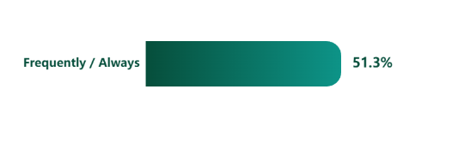
Major Findings – AI Usage
USAGE RATE
Core Purpose of Use
97.4%
Researching Topics
Summarizing Texts
Assignment Help
of students utilize AI tools daily
Usage Frequency
Primary Tool
ChatGPT is the most dominant platform.

Slide 7
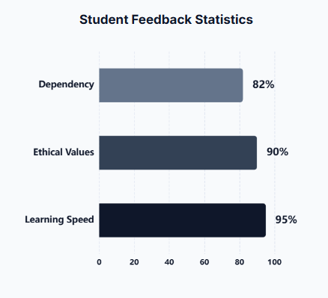






Impact on Learning & Academic Integrity
Evaluating the dual nature of AI integration in the BICTE curriculum.
Efficiency Boost
95% of students report that AI significantly accelerates the learning process and research tasks.
Rising Dependency
82% admit to a growing reliance on AI, potentially impacting independent problem-solving skills.
Integrity Paradox
While 90% value ethical boundaries, many still utilize AI for shortcuts in assignments.

Slide 8










CHALLENGES IDENTIFIED
Original Thought
Learning Shortcuts
Policy Gaps
Significant difficulty in maintaining independent critical thinking as students increasingly rely on AI-generated outputs.
High temptation to copy-paste content without fundamental understanding, leading to a decline in problem-solving skills.
A distinct lack of clear institutional policies and guidelines regarding the ethical use of AI tools in academic settings.

Slide 9










Recommendations
Strategic actions for institutional and pedagogical adaptation
AI Integration & Literacy
Guide students to use AI as a personal tutor rather than a shortcut. Teach prompt engineering and critical verification.
Assessment Reform
Shift evaluation methods to reduce AI reliance. Increase usage of oral exams, in-class practicals, and reflective journals.
Ethics & Integrity Workshops
Implement mandatory academic honesty workshops. Establish clear policies on permissible AI usage in assignments.

Slide 10










Conclusion
AI is inevitable in education; ethical use and balance with human intelligence are essential.
Unavoidable Tool
Ethical Integrity
Human-AI Balance
AI has become an essential component of modern education.
Productivity gains must be balanced with ethical boundaries.
Synergy between human thinking and AI capabilities is key.

Slide 11



Thank You!
Thank you for your attention.
I am now ready for the Question and Answer session.
PRESENTED BY
Abishek Khawas
Sukuna Multiple Campus
BICTE Student
Tribhuvan University, Nepal

